Slide 1
Delete this slide before presenting
Division of BioMed and the Warren Medical School PowerPoint Template
This template offers a variety of slide layouts, which capture different content types. This presentation is designed with the user in mind and offers clear, concise slides with accessibility considerations.
Notes:
Tips / delete before presenting

Slide 2
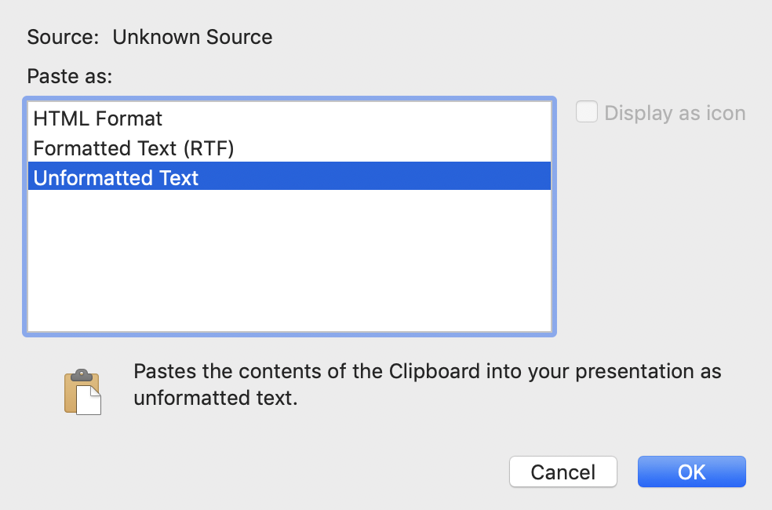
Tips - delete slide before presenting
Delete this slide before presenting
Please review the template slides to see the formats available before deleting and building your presentation (or simply copy your content to the slides you need and delete those you don’t).
If you are copy and pasting content from a previously created deck, make sure to use the following command: Edit>Paste Special>Unformatted Text
Using this command will retain the style and formatting of each text box associated in this template.
Theme fonts and recommended sizes by use:
Arial Regular
Headings, 40 pt.
Georgia Regular
Body copy, 26 pt
(consider 30 pt for deep rooms and audiences far from screen)
Charts and Graphs, 18 pt recommended (16 pt. minimum)
University Color Palette included at the top of color options for ease of use:
Notes:
Tips / delete before presenting

Slide 3
Delete this slide before presenting
Title slides
Use one of the following slide options for the title slide of the presentation.
Notes:
Tips / delete before presenting

Slide 4
Title of Presentation
Subhead
First Last, Title
Date

Slide 5
Title of Presentation
Subhead
First Last, Title
Date

Slide 6
Title of Presentation
Subhead
First Last, Title
Date

Slide 7
Title of Presentation
Subhead
First Last, Title
Date

Slide 8
Delete this slide before presenting
Content slides
Use the following slide options to present bulleted content.
Notes:
Tips / delete before presenting

Slide 9
Agenda
Item one
Item two
Item three
Division of Biology and Medicine

Slide 10
Default list w/bullets
Content level one
Content level one
Content level one
Content level one
Division of Biology and Medicine

Slide 11
Bullets w/sub-bullets
Content level one
Content level two
Content level two
Content level one
Content level two
Content level two
Division of Biology and Medicine
Notes:
Secondary; bullets with multiple levels

Slide 12
Default list w/bullets Two-line title
Content level one
Content level two
Content level three
Division of Biology and Medicine
Notes:
Secondary; two line time with mixed bullets

Slide 13
Bullets w/subhead
Subhead
Content level one
Content level two
Content level one
Content level two
Content level one
Content level two
Division of Biology and Medicine
Notes:
Secondary; bullets with subhead / multiple levels

Slide 14
Two columns w/subhead
Subhead
Subhead
Content level one
Content level one
Content level one
Content level one
Content level one
Content level one
Content level one
Content level one
Division of Biology and Medicine

Slide 15
Division of Biology and Medicine

Slide 16
Division of Biology and Medicine

Slide 17
Section or transition slide
The following slide is used to create a clear separation or transition between sections of the presentation.
Division of Biology and Medicine

Slide 18
Delete this slide before presenting
Quote or single message slide
The following slide is used for a quote or a slide message without a visual.
Notes:
Tips / delete before presenting

Slide 19
Division of Biology and Medicine

Slide 20
Division of Biology and Medicine

Slide 21
Delete this slide before presenting
Data Slides
The following slides are used to present facts, figure and numbers. It is recommended that Excel is used to capture the data points and a draft of the chart.
Notes:
Tips / delete before presenting

Slide 22
Division of Biology and Medicine

Slide 23
Division of Biology and Medicine

Slide 24
Division of Biology and Medicine

Slide 25
Delete this slide before presenting
Discussion/Question Slides
Choose one of the following slides based on what you want your audience to do at the end of the presentation.
Notes:
Tips / delete before presenting

Slide 26
Division of Biology and Medicine

Slide 27
Division of Biology and Medicine

Slide 28
Delete this slide before presenting
Thank you slides
Choose one of the following slides to end your presentation.
Notes:
Tips / delete before presenting

